Slide 1
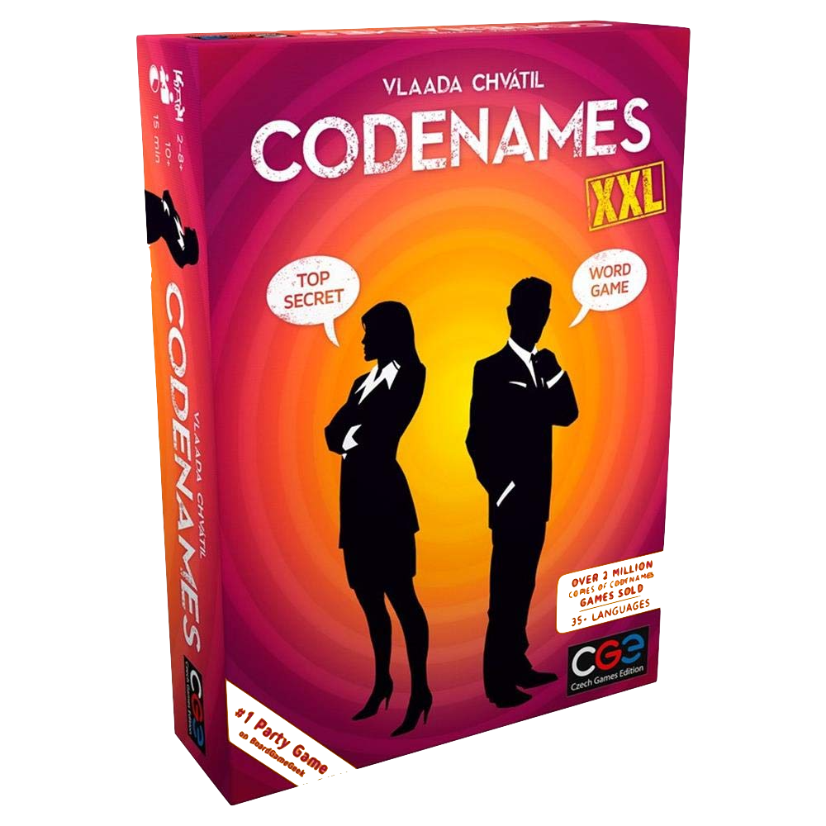

The Perfect Partner: Codenames AI Bot
Notes:
Leveraged Gensim’s word2vec to build a bot that can play a popular game called Codenames, a game that involves word similarity

Slide 2
Codenames Instruction Manual
(Suggested Players: 4+)
Notes:
To quickly explain the game

Slide 3
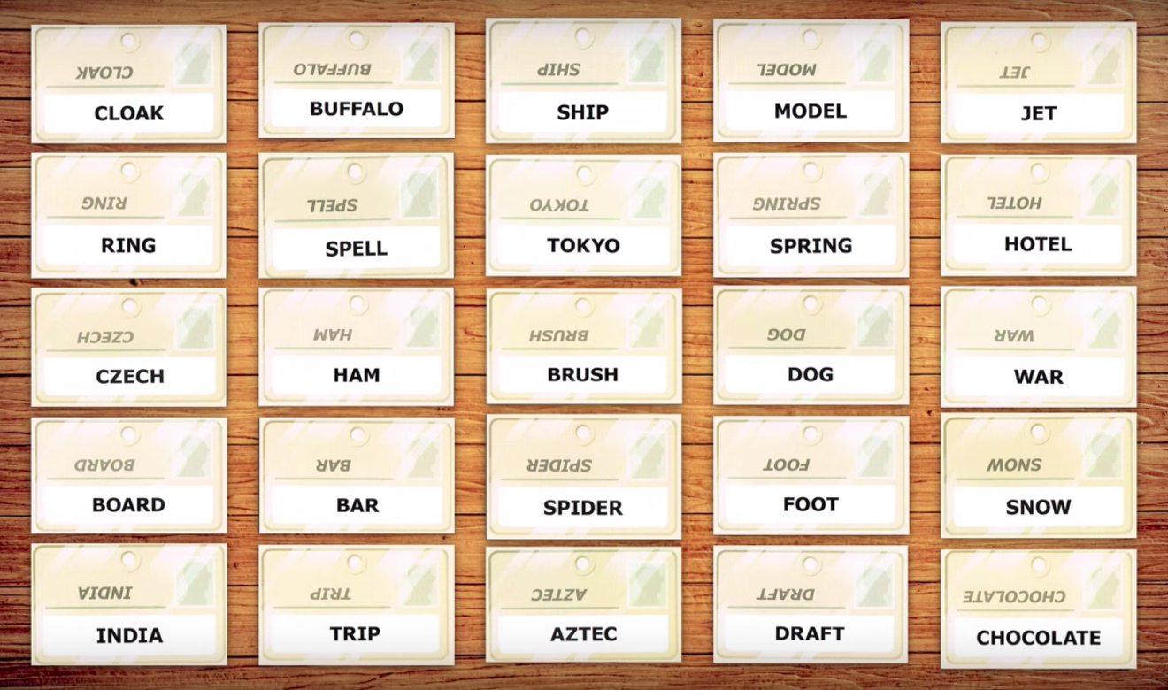
Notes:
There are 2 teams, red and blue. The object of the game is to guess your words without guessing the opponents

Slide 4
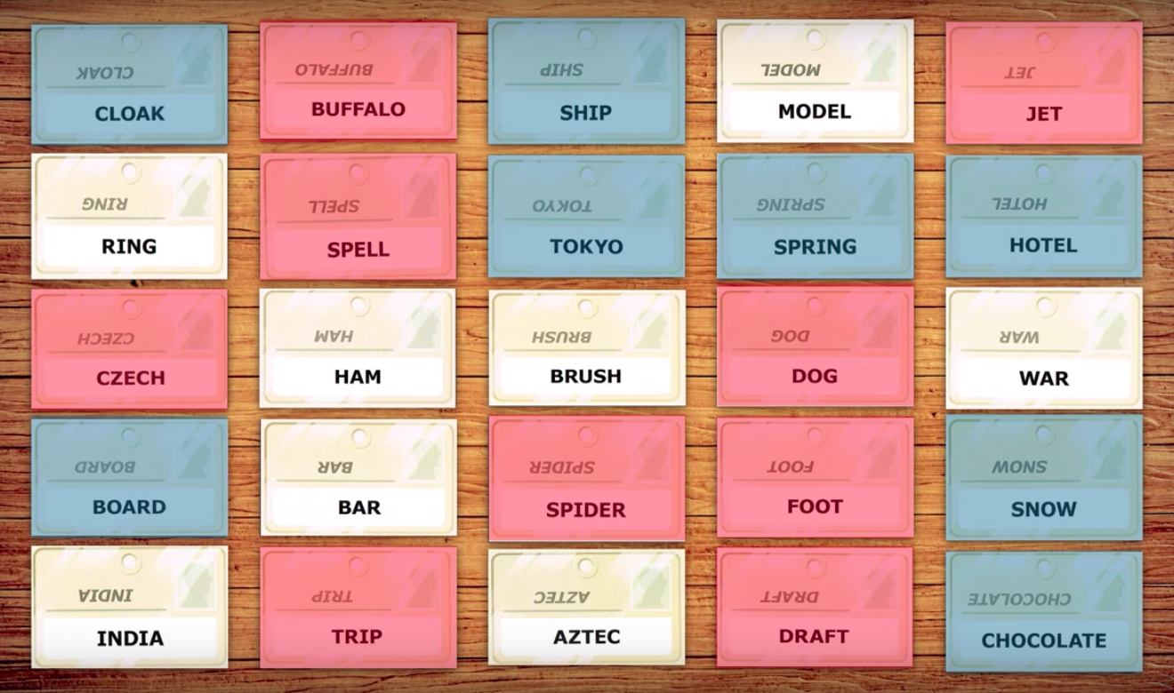
Notes:
One person on each team is the ‘cluegiver’ and knows which words are assigned to what team. Their job is to give clues to guessers pointing them to their words

Slide 5
CLUE: ANIMAL 3
Notes:
So quickly, if the cluegiver says “animal 3”, one should guess buffalo, dog, and spider

Slide 6
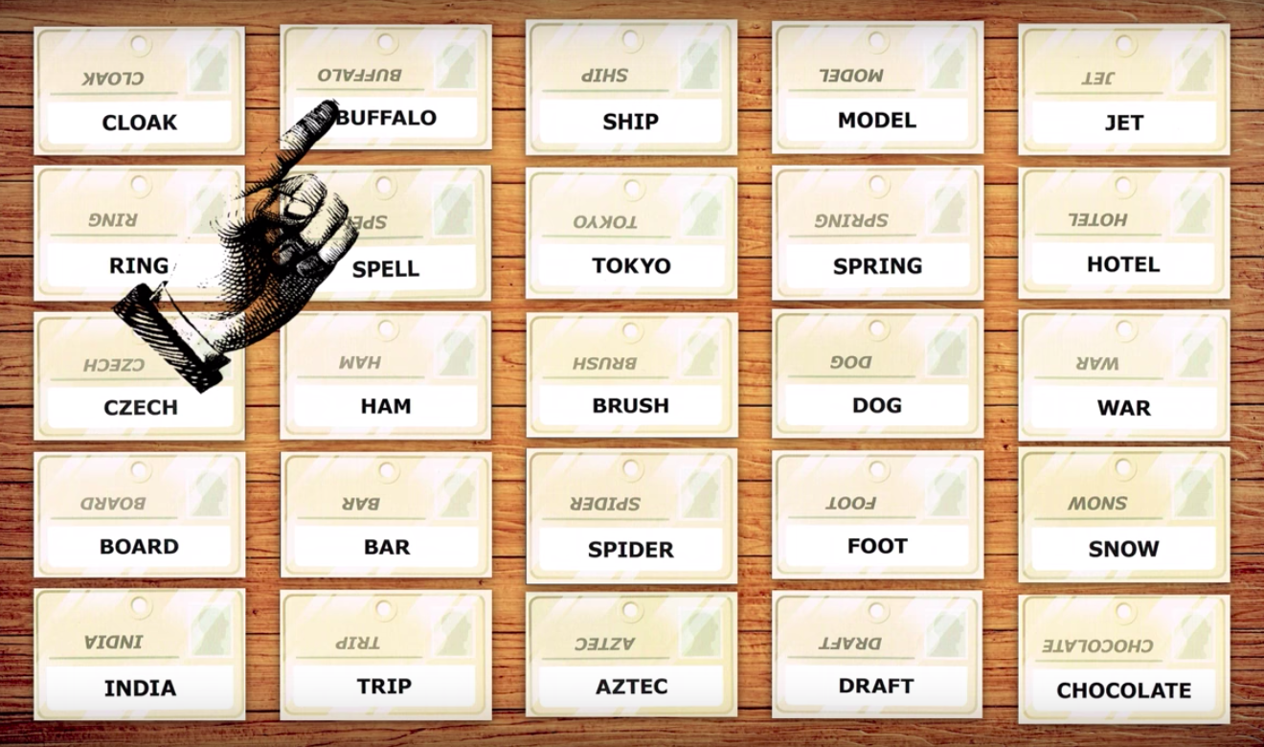
CLUE: ANIMAL 3

Slide 7
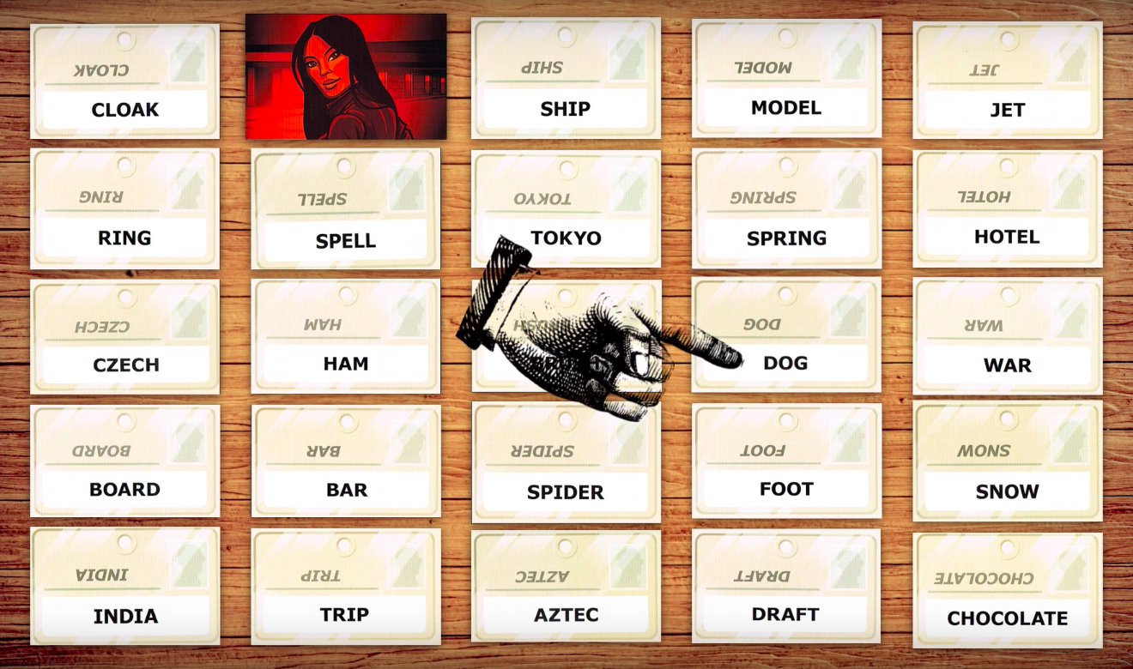
CLUE: ANIMAL 3

Slide 8
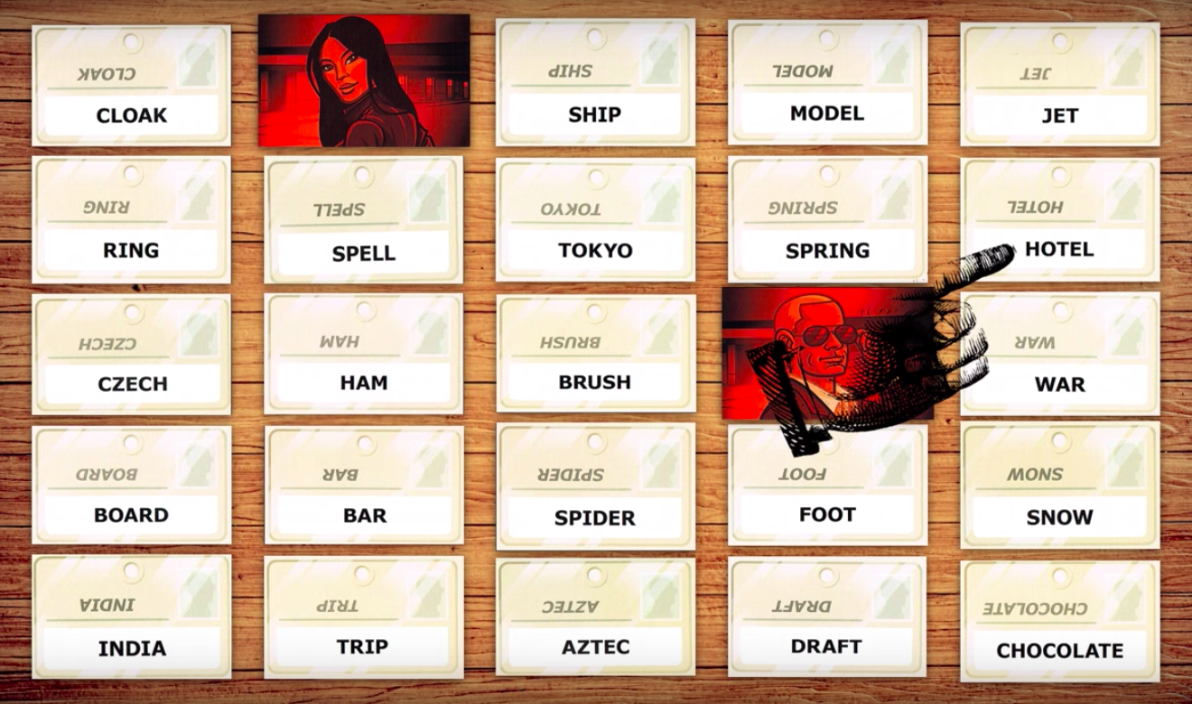
CLUE: ANIMAL 3
Notes:
But if they guess “hotel” (a word on the other team) then they get penalized and my model takes that into consideration

Slide 9
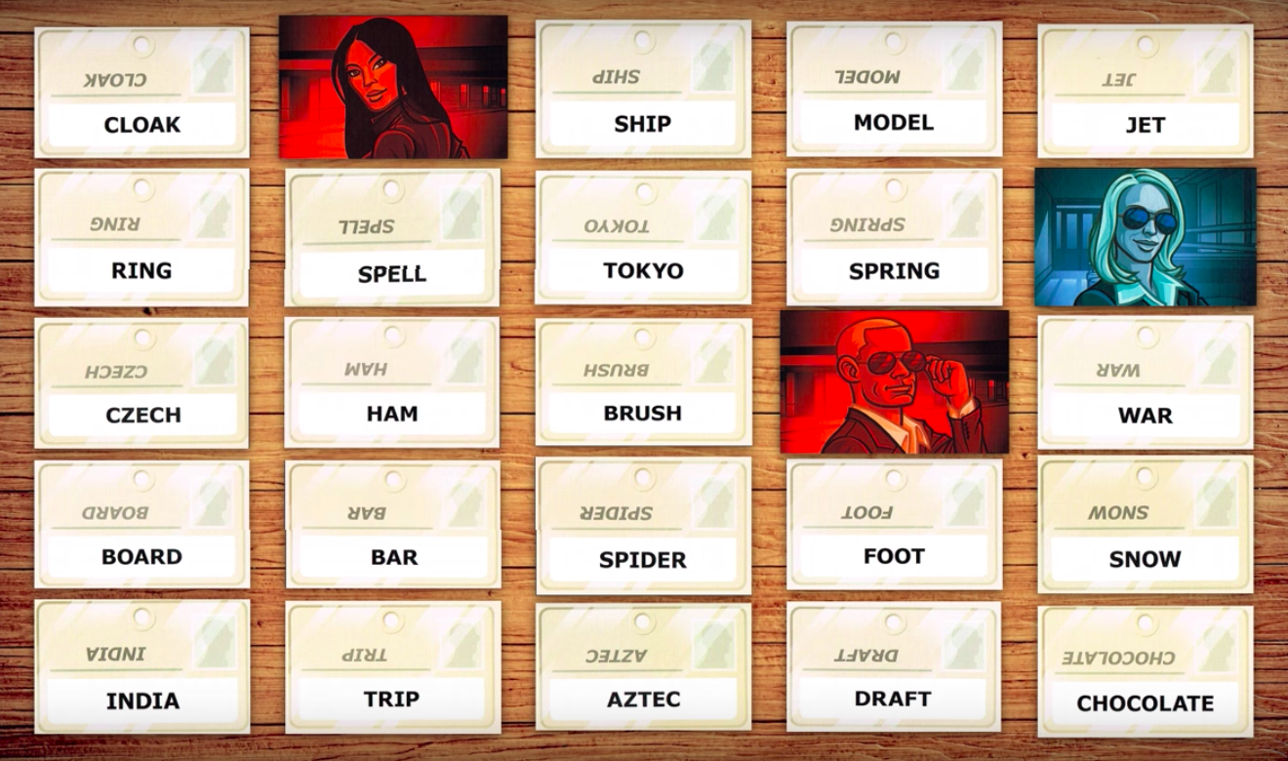
CLUE: ANIMAL 3
Notes:
But if they guess “hotel” (a word on the other team) then they get penalized and my model takes that into consideration

Slide 10

Notes:
Teams alternate turns and the first team to guess all their words wins

Slide 11


Notes:
Teams alternate turns and the first team to guess all their words wins

Slide 12
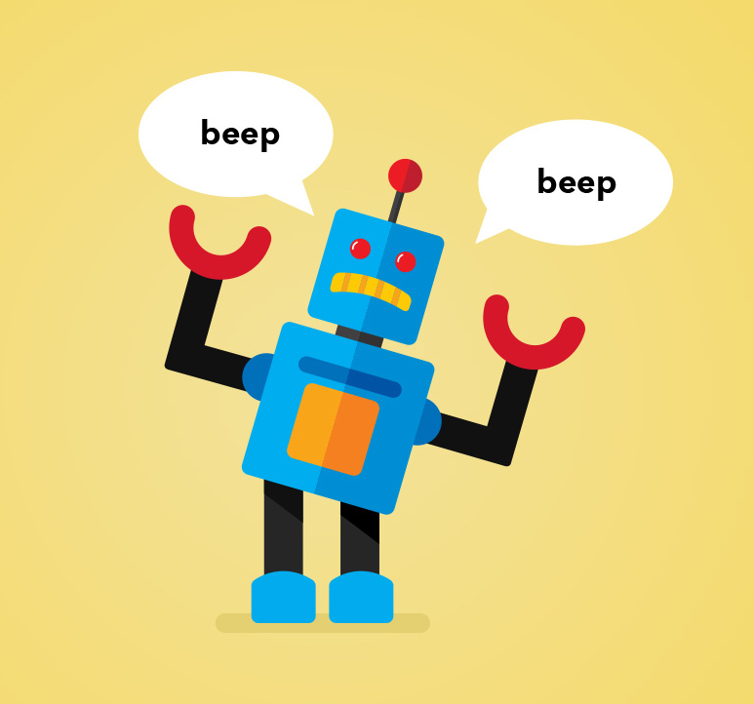
HELLO!
I am Cody the Codegiver
I am here because Patrick needs a partner.
Notes:
I built AI Cody with dual functionality that’s capable of giving clues as well as guessing words from my clues so that it can effectively play this game as my partner

Slide 13

1.
Creating Bot Logic as Cluegiver
(Using Gensim Word2Vec)
Notes:
The first part, I built Cody as the Cluegiver using a pre-trained google news word2vec model . As the name implies, the model turns words into a vector using a neural network

Slide 14
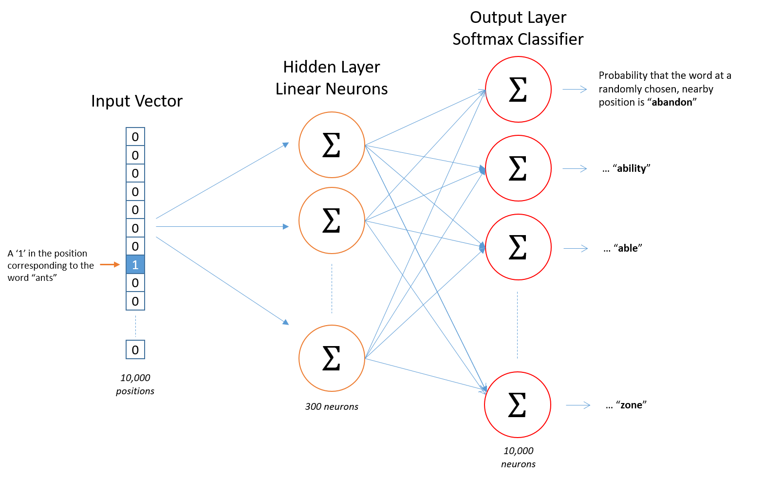
Gensim Word2Vec Model
Notes:
Words sharing similar contexts also share a similar meaning and consequently a similar vector representation from the model
It can then calculate how similar the words are using cosine similarity of the vectors

Slide 15
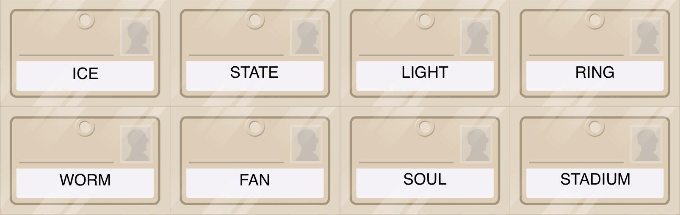
AI Cody’s Logic as Cluegiver
Look at all word combinations of his words
2⁸ = 256 combinations!
Notes:
Takes available words, and finds all combinations. 8 words now so 256 combinations, and runs the model on each combination

Slide 16
AI Cody’s Logic as Cluegiver
Highest 1 word similarity score: ballpark (0.68)
Cody’s Clue: Ballpark 1
Notes:
So out of all 1 word combinations, highest similarity score is with stadium, and the clue is ballpark

Slide 17
AI Cody’s Logic as Cluegiver
Highest 2 word similarity score: brilliance (0.54)
Cody’s Clue: Brilliance 2
Notes:
Out of all 2 word combinations, highest similarity score uses light and ring, and the clue is brilliance

Slide 18
AI Cody’s Logic as Cluegiver
Highest 3 word similarity score: arena (0.49)
Cody’s Clue: Arena 3
Notes:
threshold algorithm to gauge how many words he should connect
Although we want to try to connect more words, deduced that any 4 word combination will be too risky

Slide 19
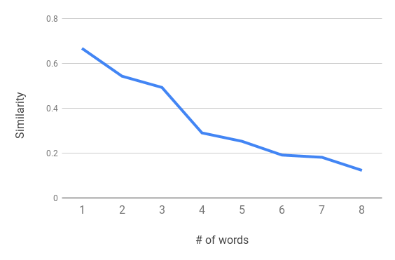
AI Cody’s Logic as Cluegiver
Similarity Loss with each additional word
Notes:
How does it know that? It looks at the similarity loss with each additional word. It’s harder to connect more words so naturally the score will drop

Slide 20
AI Cody’s Logic as Cluegiver
Similarity Loss with each additional word
Notes:
But this slope between 3 and 4 words represents an extreme drop in similarity. So much so, that Cody only feels comfortable recommending 3.

Slide 21
AI Cody’s Logic as Cluegiver
Similarity Loss with each additional word
Stay at 3 words!
Notes:
The algorithm uses the min, max and average slope to calculate the risk threshold. It also has discrete thresholds for each # of words as a second layer of protection

Slide 22

2.
Transfer Learning with personalized word embeddings
(With personal Facebook message data)
Notes:
What good is a perfect partner if it doesn’t know how you talk!

Slide 23
Adding Personal Facebook Message Data
Trained Word2Vec model on my Facebook Messages
Top 5 words relating to the word “Game”:
Pre-trained Google News:
Play
Match
Opener
Tournament
League
Trained on my Facebook:
Playoff
Giants
Season
NBA
Football
Notes:
Good but broad words. MORE SPECIFIC words

Slide 24
Adding Personal Facebook Message Data
Trained Word2Vec model on my Facebook Messages
Top 5 words relating to the word “Game”:
Google News:
Play
Match
Opener
Tournament
League
Facebook:
Playoff
Giants
Season
NBA
Football
Weighted Average:
Win
Giants
Playoff
Poker
Knicks
Notes:
Using weighted average with Facebook/Google Model word vectors… HIGHLY PERSONALIZED words
Personal model can point out my favorite sports teams and other games I enjoy playing like Poker

Slide 25

3.
Creating Bot Logic as Guesser
(Adding functionality)
Notes:
Other functionality is Cody guessing words on the board based on the clue I give it

Slide 26
CLUE: ANIMAL 3
Notes:
Cody as Guesser looks at my clue and trains Cosine Similarity of the Clue word Vector (animal) to available board words

Slide 27
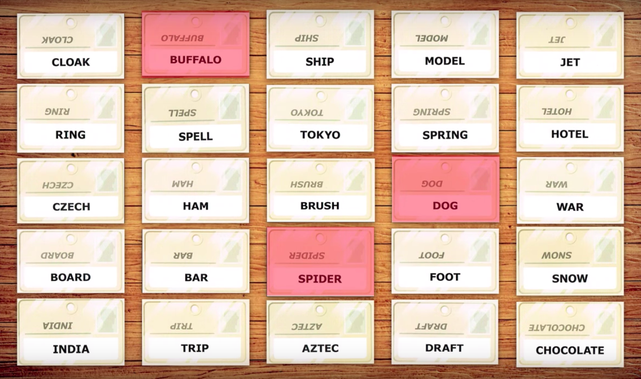
CLUE: ANIMAL 3
0.39
0.64
0.33
Notes:
Here there is another multi-step thresholds process, even animal 8 will give me same result.

Slide 28
CLUE: ANIMAL 8
0.39
0.64
0.33
Same results!
Notes:
This model is dynamic, and will constantly re-train only on the available words

Slide 29
4.
Programming the gameplay
(Built an interface from start to finish)
Notes:
Build an interface

Slide 30
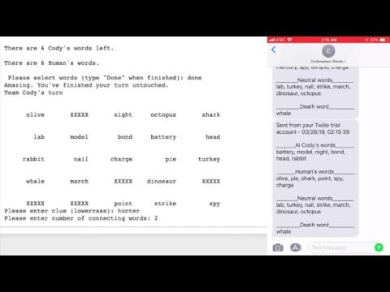

Slide 31
THANKS!
Any questions?
You can email me at:
PYL252@nyu.edu
linkedin.com/in/patrickylee-1

